Slide 1
APA Figures and Tables
Lecture 12

Slide 2
Purposes of data displays
Exploration: The data contain a message, and you would like to learn what it is
Communication: You have discovered the meaning contained in the data and want to tell others about it
  This is the traditional purpose of most data displays in scientific documents
Calculation: The display allows you to estimate some statistic or function of the data
Storage: You can store data in a display for retrieval later, including the results of a study for later use in a meta-analysis
Decoration: Data displays attract attention, and you may choose to use them to make your manuscript more visually appealing

Slide 3
Design your graphical display with the reader in mind
Place items that are to be compared next to each other
Place labels so that they are clearly about the elements are labeling
Use fonts that are large enough to be read without the use of magnification
Include all of the information needed to understand it within the graphical image – avoid novel abbreviations, use table notes, and label graphical elements
Keep graphical displays free of extraneous materials, no matter how decorative the materials may make the graphic look

Slide 4
Table and figure numbers
Number all tables and figures with Arabic (e.g., Table 1, Table 2, Table 3, etc.) in the order in which they are first mentioned in text, regardless of whether a more detailed discussion of the table or figure occurs later in the paper
Tables and figures are numbered separately
If the paper includes an appendix with tables or figures, identify tables and figures from the appendix with capital letters and Arabic numbers (e.g., Table A1 is the first table of appendix A and Table C2 is the second table of appendix C)

Slide 5
Discussing tables and figures in text
Tables and figures should supplement (not duplicate) the text
Refer to ALL tables and figures
Discuss the table or figure’s highlights
Refer to tables and figures by their number
  Do NOT refer to them as “the table above” or “the figure on # page”

Slide 6
Tables

Slide 7
Titles and headings
Table titles should provide a brief and clear explanation of the table describing the table’s basic content
Table headings establish the organization of the data and identify the columns of the data beneath
  Each column of the table should have a heading
  All headings refer to the information below them, not across from them
  Do not number headings unless your table is a correlation matrix

Slide 8
Notes
General notes qualify, explain, or provide information relating to the table as a whole
  This includes explanations of abbreviations and symbols. It can also include acknowledgements
  Should start with the word “Note” in italics and followed by a period
Specific notes refer to a particular column, row, or cell
  Indicated by a superscript lowercase letter (e.g., ª)
Probability notes indicate how asterisks and other symbols are used in a table to indicate p-values
  It’s usually a better idea to report exact probabilities to two or three decimal places than to use asterisks or other symbols to indicate vague p-values (e.g., * p < .05, ** p < .01). Only use probability notes when including the exact p-values would make it difficult to comprehend the graphic.
  If probability notes are necessary, use the same number of asterisks to indicate the same p-value threshold for all tables within the paper

Slide 9
Information
Decimal values should be reported to the same number of decimal paces for all comparable values
Empty cells which are not filled because not applicable should be left blank
Empty cells which are not filled because the data were not obtained or are not reported should have a dash
  By convention the main diagonal of a correlation matrix, which would indicate the correlation of a variable with itself and is always 1.00, is replaced by a dash

Slide 10
Other terms
Canonical Form: the standard form used to create the table (or figure)
Cell: point of intersection between a row and a column
Table Body: Rows of cells containing primary data of the table
Stub or Stub Column: Leftmost column of the table; usually lists the major independent or predictor variables
Column Heads: Heading that identifies the entries in just one column in the body of the table
Table Spanner: Heading that covers the entire width of the body of the table
Decked Heads: Heading that is stacked, avoids repetition of words in column headings
Column Spanner: Heading that identifies the entries in two or more columns in the body of the table
Stub Head: Heading that identifies the entries in the leftmost column

Slide 11
Figures

Slide 12
Common types of figures
Graphs typically display the relationship between two quantitative indices or between and continuous, quantitative variable and a group of subjects
Charts generally display nonquantitative information
  Example: A flow chart would work well to display the flow of subjects through a process
Maps generally display spatial information
Drawings show information pictorially
Photographs contain direct visual representations of information

Slide 13
Legends and captions
Legends explain the symbols used in a figure and is placed within a figure
  Should have the same lettering as the rest of the figure
  Capitalize major words
Captions are concise explanations of the figure and are placed directly below the figure.
  Serve as the figure’s title
  Should include figure number, a descriptive phrase, and any information needed to clarify the figure
  Should explain units of measurement, symbols, and abbreviations which are not included in the legend
Lettering within a figure should be large and sharp enough to be legible.
  The size of lettering should be no smaller than 8 point font and no larger than 14 point font. Sizing should be consistent throughout the figure.

Slide 14
In class demonstration

Slide 15
How to create a table in Word
Open Word
At the top of the ribbon, select “Insert” and select “Table”
Choose the number of cells by dragging your cursor
In the topmost row, type “Table #”
In the second row, type the table title (italicized)
Select “Merge and Center” for the table number and table title rows (separately). Left align both
Type and center any column names (column spanners, column heads, and stub heads)
  Column names which refer to more than one column should be merged using the “Merge and Center” button
Type data
Remove the inside and outside borders of all cells
Add borders between rows above and below column names
Type table notes as necessary in the next rows (there should be a border line above these notes, but no border line between or below notes)
Remove any excess cells

Slide 16
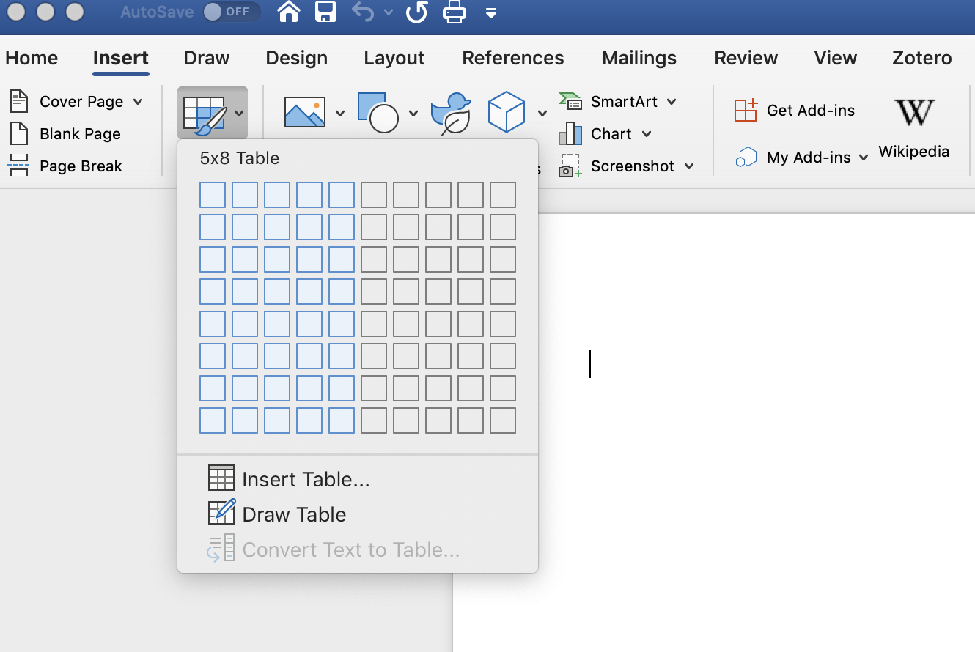
At the top of the ribbon, select “Insert” and select “Table”
Choose the number of cells by dragging your cursor

Slide 17
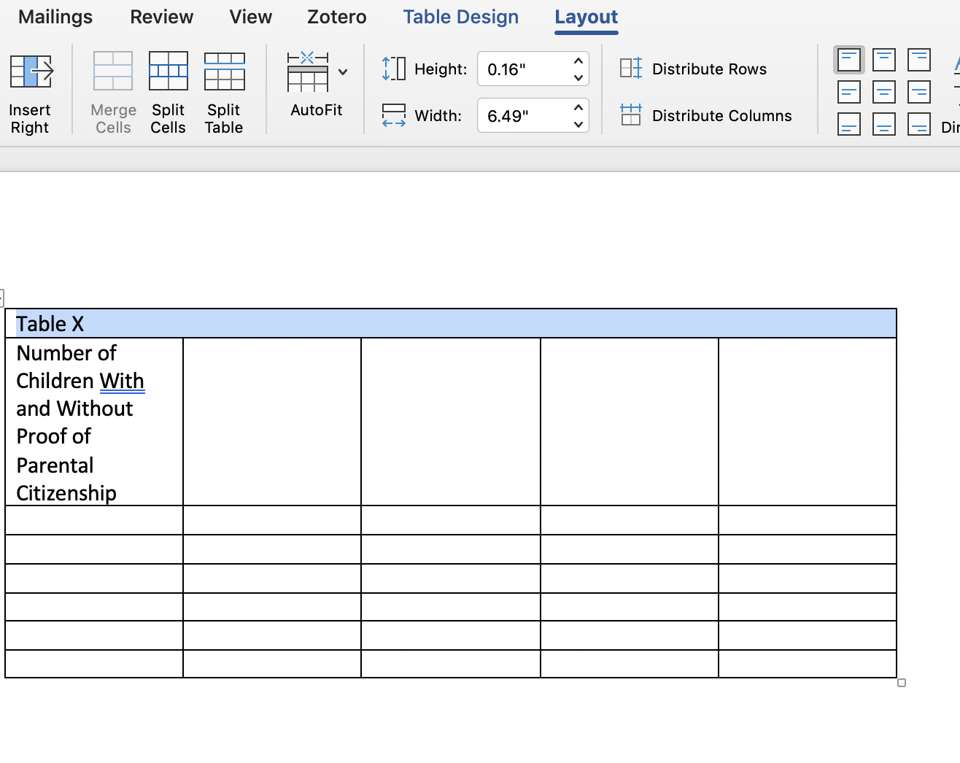
In the topmost row, type “Table #”
In the second row, type the table title (italicized)

Slide 18
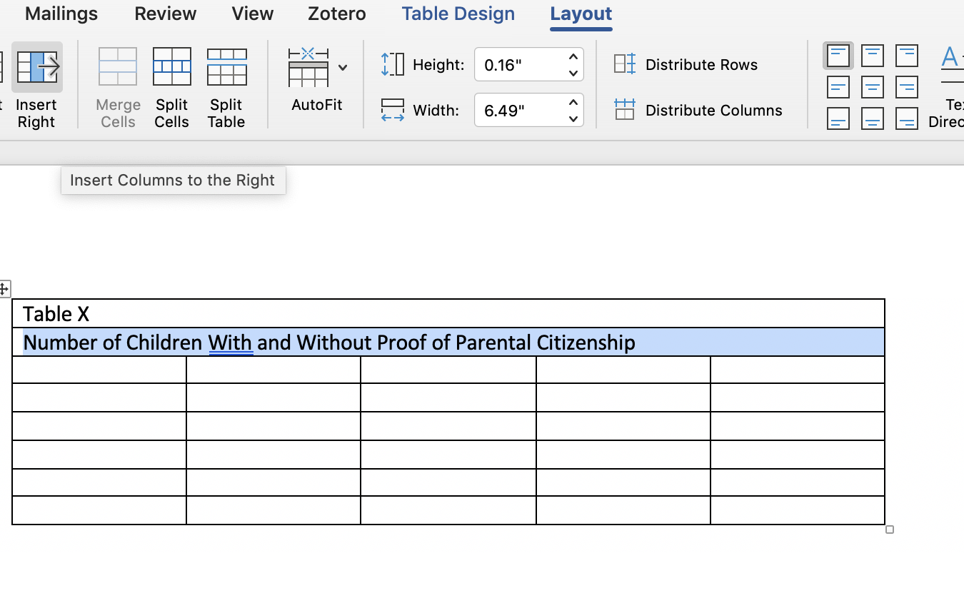
Select “Merge and Center” for the table number and table title rows (separately)
Left align both

Slide 19
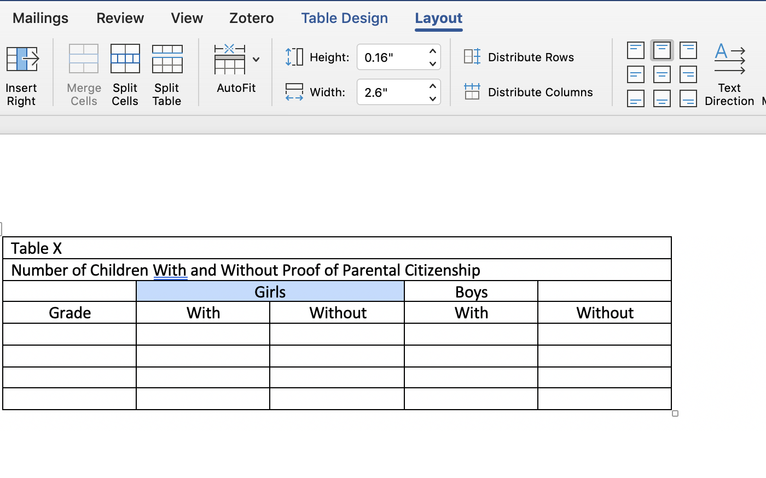
Type and center any column names
Column names which refer to more than one column should be merged using the “Merge and Center” button

Slide 20
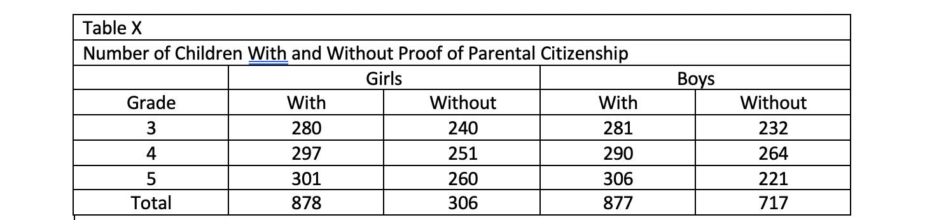
Type data

Slide 21
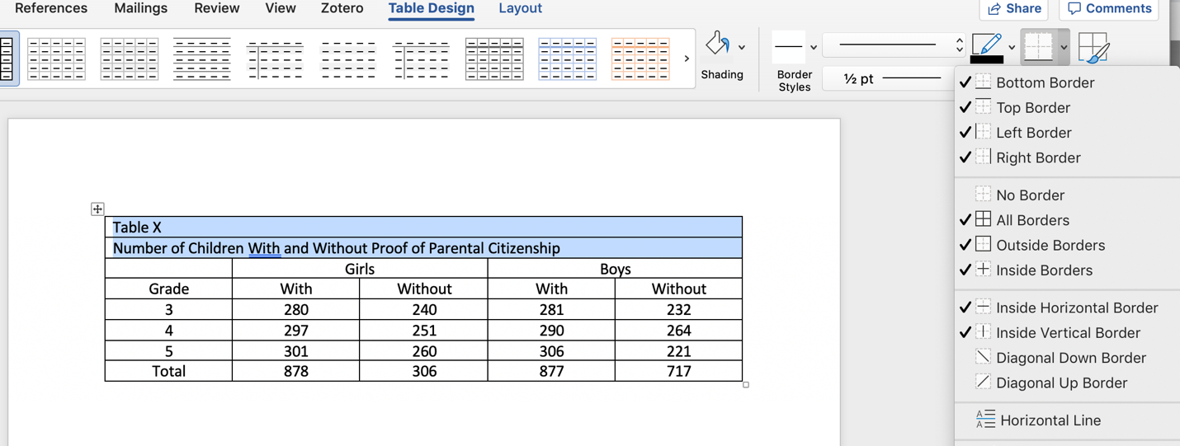
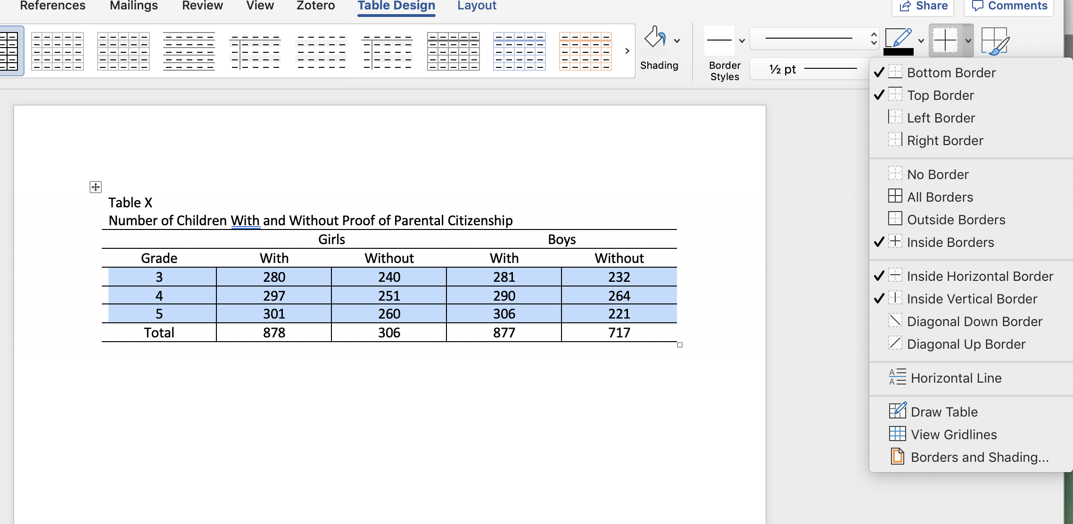
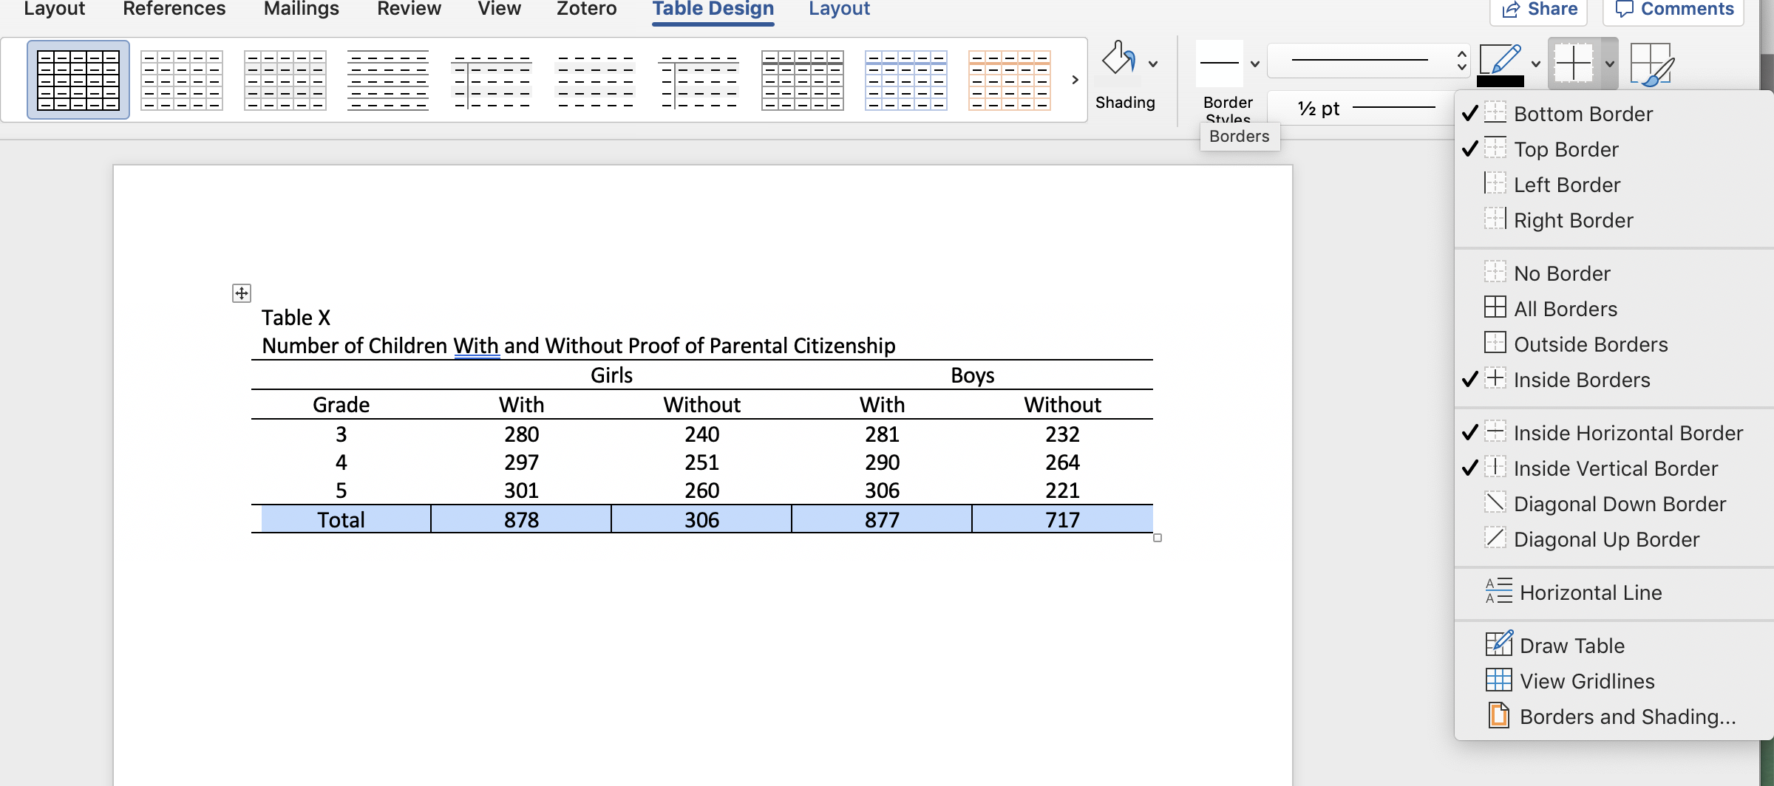
Remove the inside and outside borders of all cells
Add borders between rows above and below column names

Slide 22
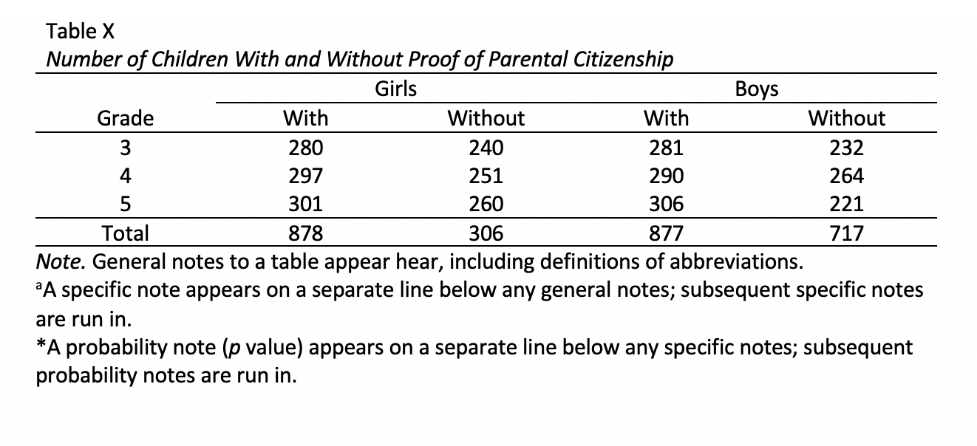
Type table notes as necessary in the next rows (there should be a border line above these notes, but no border line between or below notes)

Slide 23
How to create a figure in Excel
Open data in Excel
Highlight data by dragging your cursor over the data cells
Select “Recommended Charts”
Select the figure type which best fits your needs
Remove title and gridlines
Insert X and Y axis titles
Copy and paste into Word
Type figure description
Center figure and figure description

Slide 24
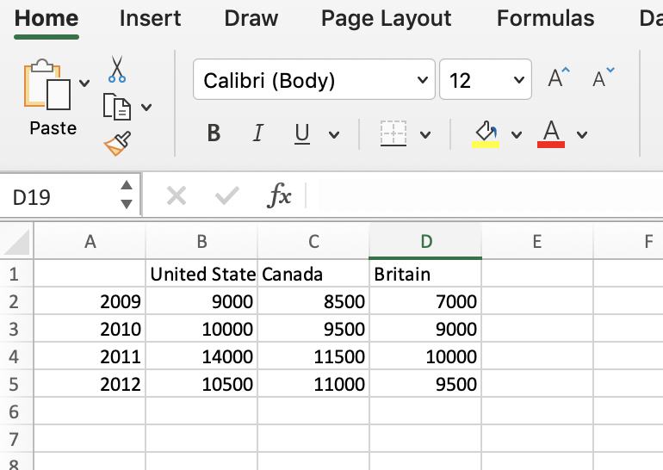
Open data in Excel

Slide 25
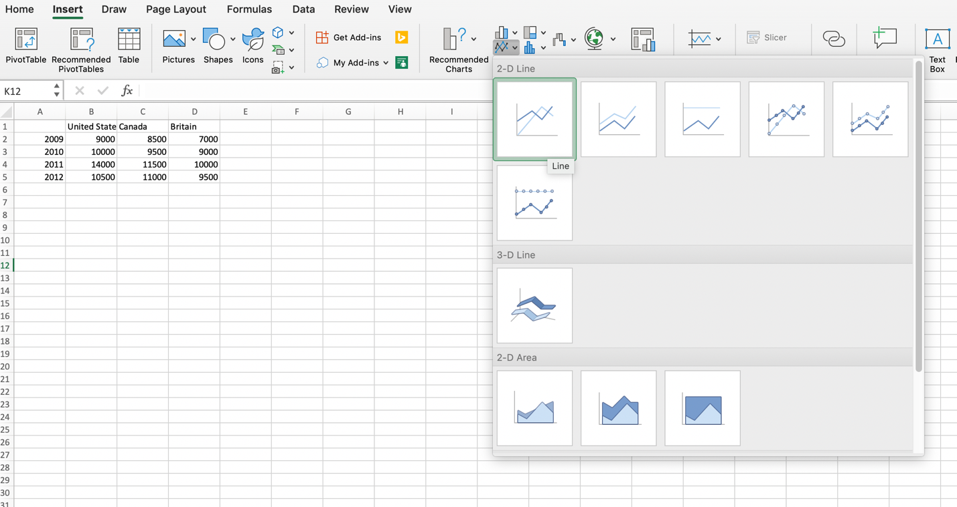
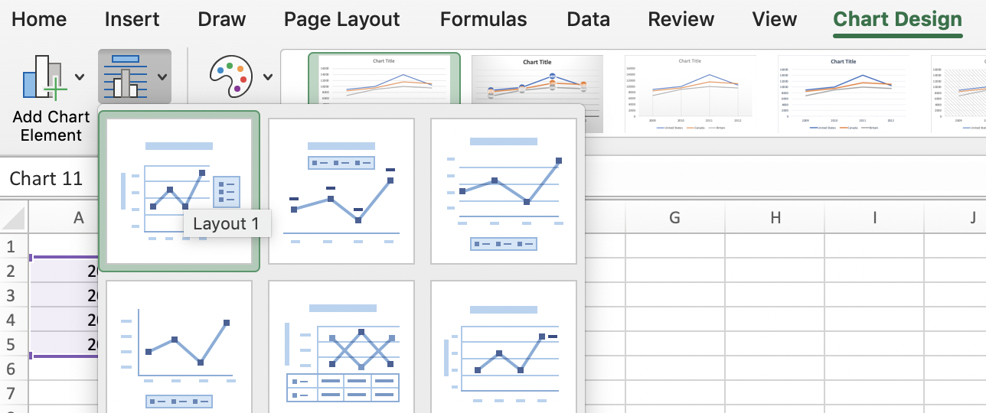
Highlight data by dragging your cursor over the data cells
Select “Recommended Charts”
Select the figure type which best fits your needs

Slide 26
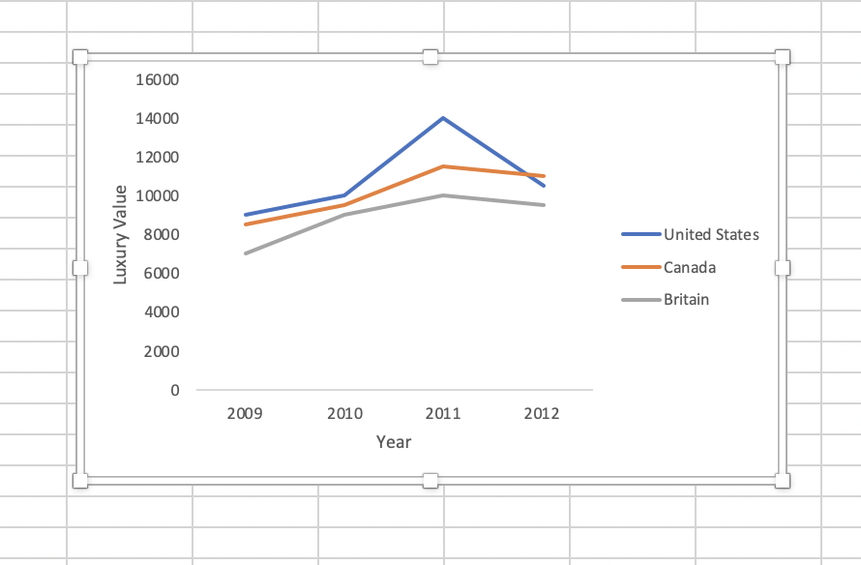
Remove title and gridlines
Insert X and Y axis titles

Slide 27
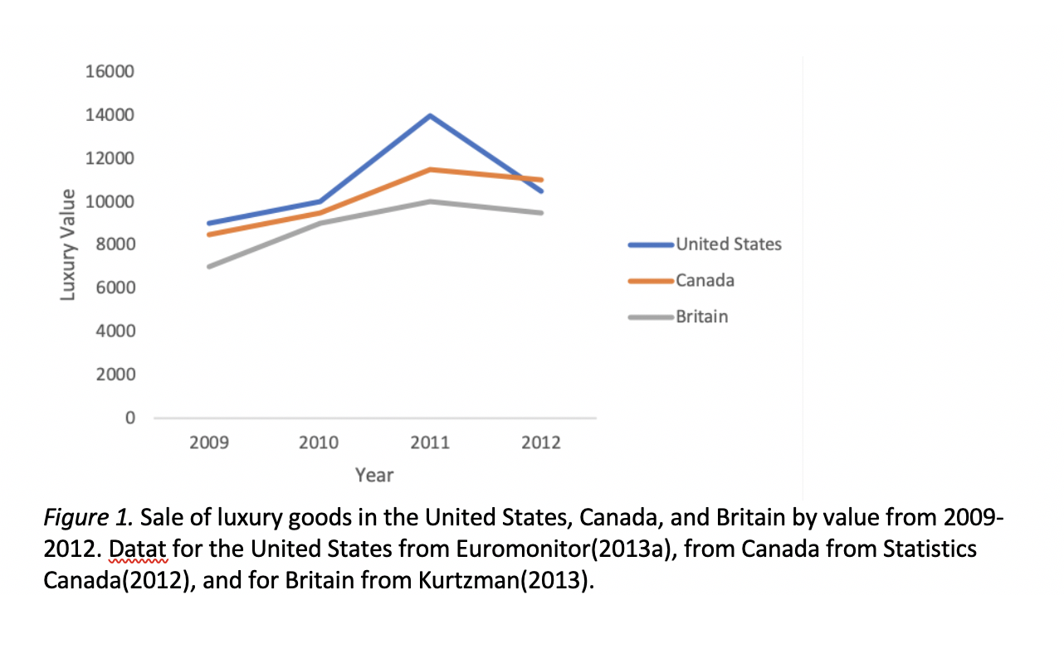
Copy and paste into Word
Type figure description
Center figure and figure description

Slide 28
It’s your turn

Slide 29
Background for Juror.csv
Participants are asked to read a vignette about a situation in which John has a few drinks at a New Year’s Eve party and hits a person with his vehicle on the way home. Participants are then asked to recommend an appropriate sentence for the crime. The only thing about the vignette which changes is John’s occupation.
Occupation is the IV
  1 – John is an architect
  2 – John is a gang member
  3 – John is an accountant
Sentence is the DV
  Participants suggested the number of years in prison which they felt was appropriate for the crime
Hypothesis: Participants will suggest longer prison sentences for the gang member than for either the architect or accountant.

Slide 30
In class assignment
Use “Juror.csv”
Create a table in Word of the means and standard deviations for each condition
Create a figure in Excel of the means for each condition
Paste your figure into the Word document beneath the table
Be sure to format the table and figure in APA format
Which of the two (table or figure) do you think best represents this data?
Submit your Word document on Blackboard. This is a group activity, so only one of you need to submit the activity.

Slide 31
Complete your “Quiz” on Blackboard
This is due before the usual class time on Wednesday
The quiz will be timed, so please read the 5th chapter of the APA Publication Manual BEFORE you complete the quiz

